Slide 1
Political Science
Introduction
Lecture 9
Marem Buzurtanova
Al-Farabi KazNU
Almaty 2022

Slide 2
Political Science, Introduction, Lecture 9
LECTURE 9 covers the following;
1. Political Science, its Scope and Focus:
1.1. Subject of Study, Level and Unit of Analysis;
2. Political Science, its Categories:
2.1. Politics;
2.2. Power and Political Power;
2.3. State;
2.4. Political Actor and Political Action;
2.5. Political Choice and Political Behavior.

Slide 3
Political Science, Introduction, Lecture 9
Terms and Notion in Political Science
Power government
Political power
State type of government constitution
Political action
Political actor
political instruction
Political choice legitimacy of power
political party Political behaviour

Slide 4
Political Science, Introduction, Lecture 9
Why do we need political science?
- to learn, to gain new knowledge and systematize the existing knowledge about the political;
- to form a system of values, to assess political decisions, political institutions, political events;
- to build theories and methodologies to study the political;
- to socialize in a political environment;
- to make prognoses about the political processes.

Slide 5
Political Science, Introduction, Lecture 9
Subfields of Political Science:
comparative politics,
political economy,
international relations,
political theory,
public administration,
public policy,
and political methodology.
Political science economics, law, sociology, history, philosophy, human geography, journalism, political anthropology and social policy.

Slide 6

Political Science, Introduction, Lecture 9
Political science is a science of politics
Politics:
social relations;
power relations,
political organization of society (state);
political institutions, principles, norms, and action.

Slide 7
Political Science, Introduction, Lecture 9
Politics is a struggle of many interests;
Politics is the management of resource allocation and distribution;
Politics is the acquisition, retention and use of power;
Politics is participation in the affairs of the state, its government and governance, definition of the forms, tasks, content of the state's activities;
Politics is a struggle for the right to establish its own rules of the game;
Politics is the art of bringing people together;
Politics is the art of evil in the name of good.

Slide 8
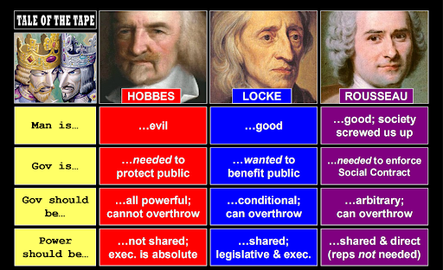
Political Science, Introduction, Lecture 9
FUNCTIONS OF POLITICS:
expression of the political interests;
resolution of conflicts and maintenance of social cohesion;
exercising political leadership;
government and governance.
what is the state?

Slide 9
Political Science, Introduction, Lecture 9
State
The state is a human community that successfully claims the monopoly of the legitimate use of physical force within a given territory (M.Weber, 1946).
The state as a person of international law should possess the following qualifications: (a) a permanent population; (b) a defined territory; (c) government; and (d) capacity to enter into relations with the other states The Montevideo Convention on the Rights and Duties of States, 1933).

Slide 10
Political Science, Introduction, Lecture 9
Power
Power is a capacity to impose one’s will upon someone, to alter and manage one’s behaviour. According to M.Weber, power comes from:
Violence (physical force, threat of use of force);
Authority (family and social ties, charisma, expert (special) knowledge, faith);
Law (position and authority, control over resources, custom and tradition).

